Slide 1

Devops & Docker

Slide 2
Devops & Docker
Why Devops
Virtualization & Containerization
Building and Running Docker Images
Common Docker Commands
Docker-Compose & Volumes

Slide 3
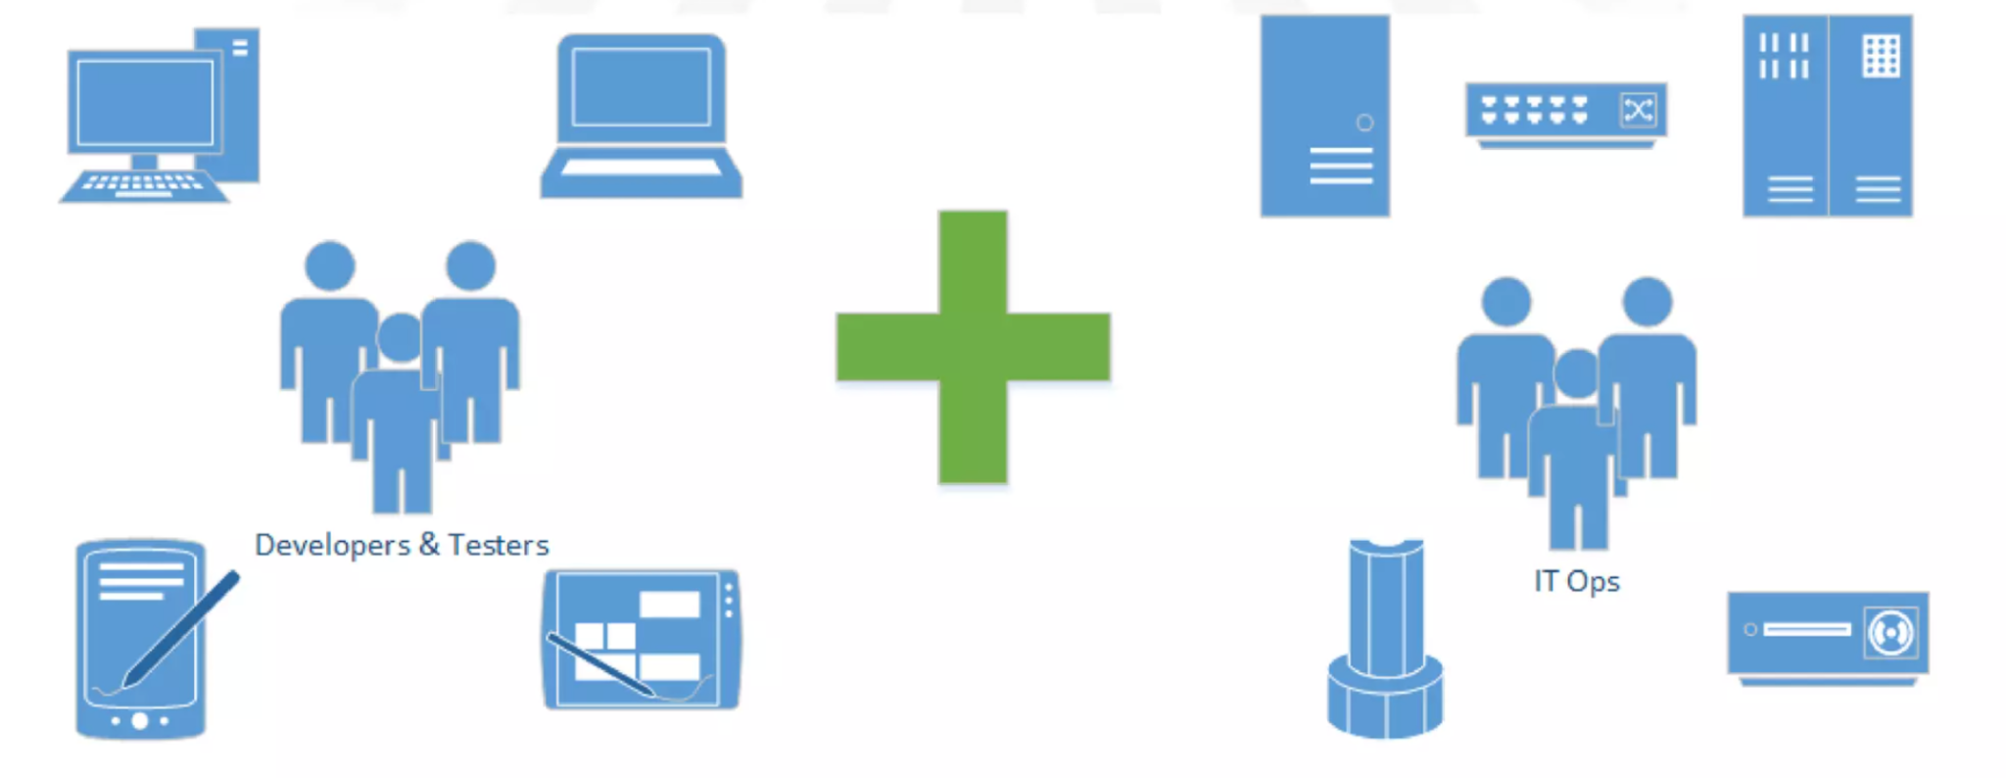
Before DevOps

Slide 4
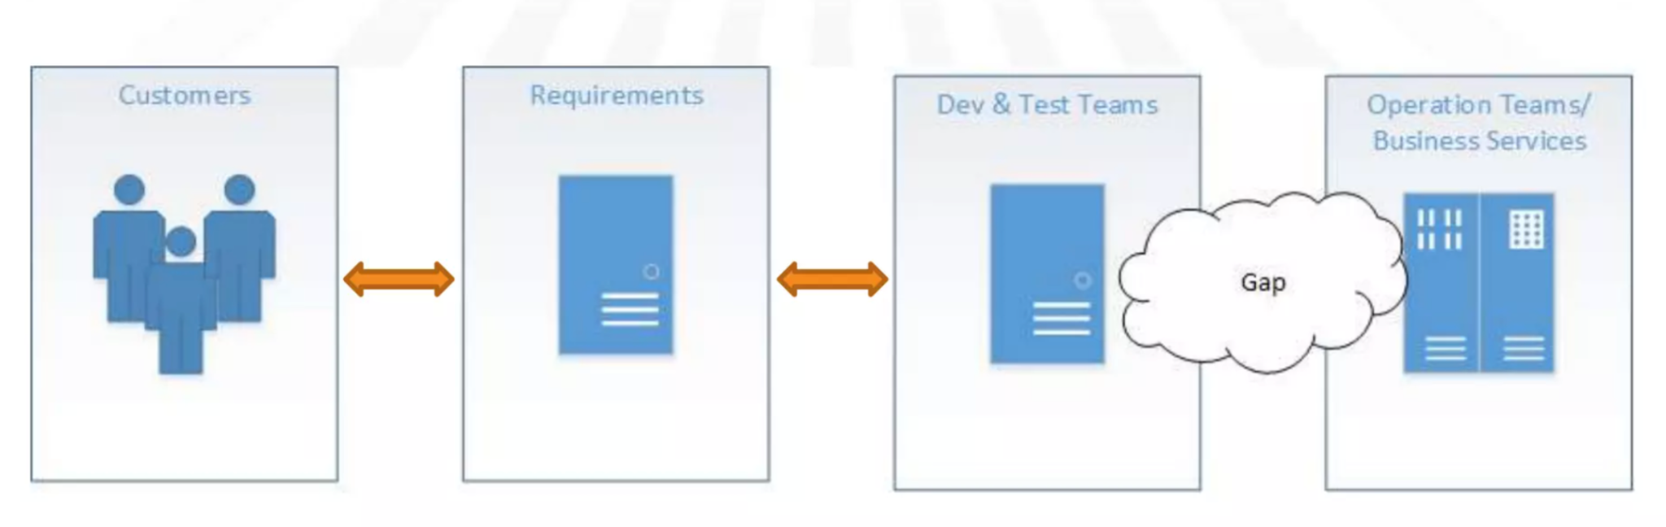
Why DevOps?

Slide 5
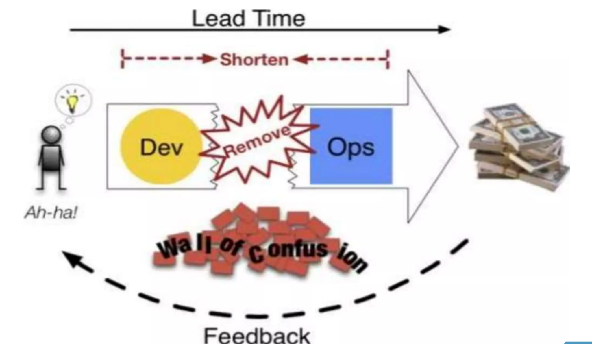
Why DevOps?

Slide 6
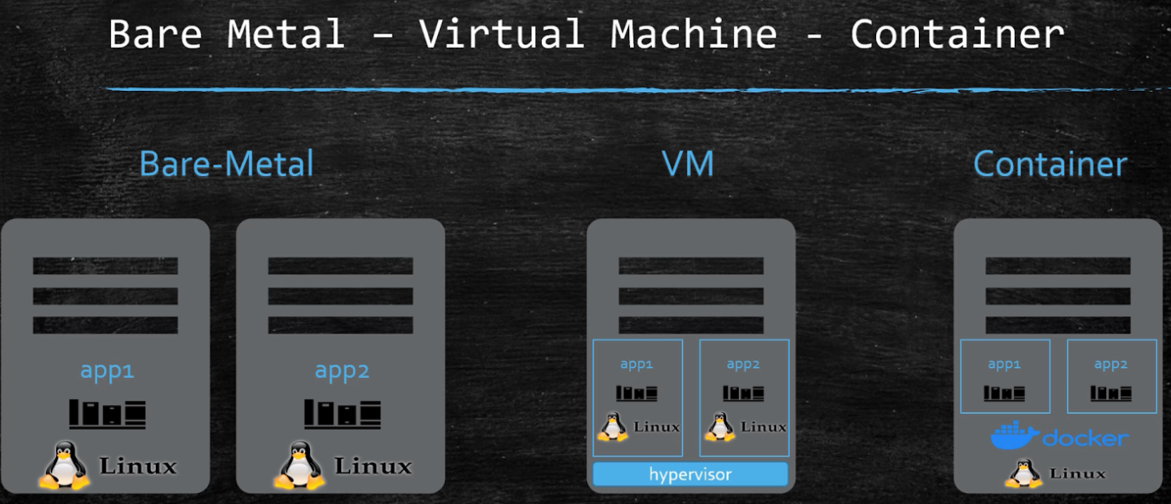
Containerization

Slide 7
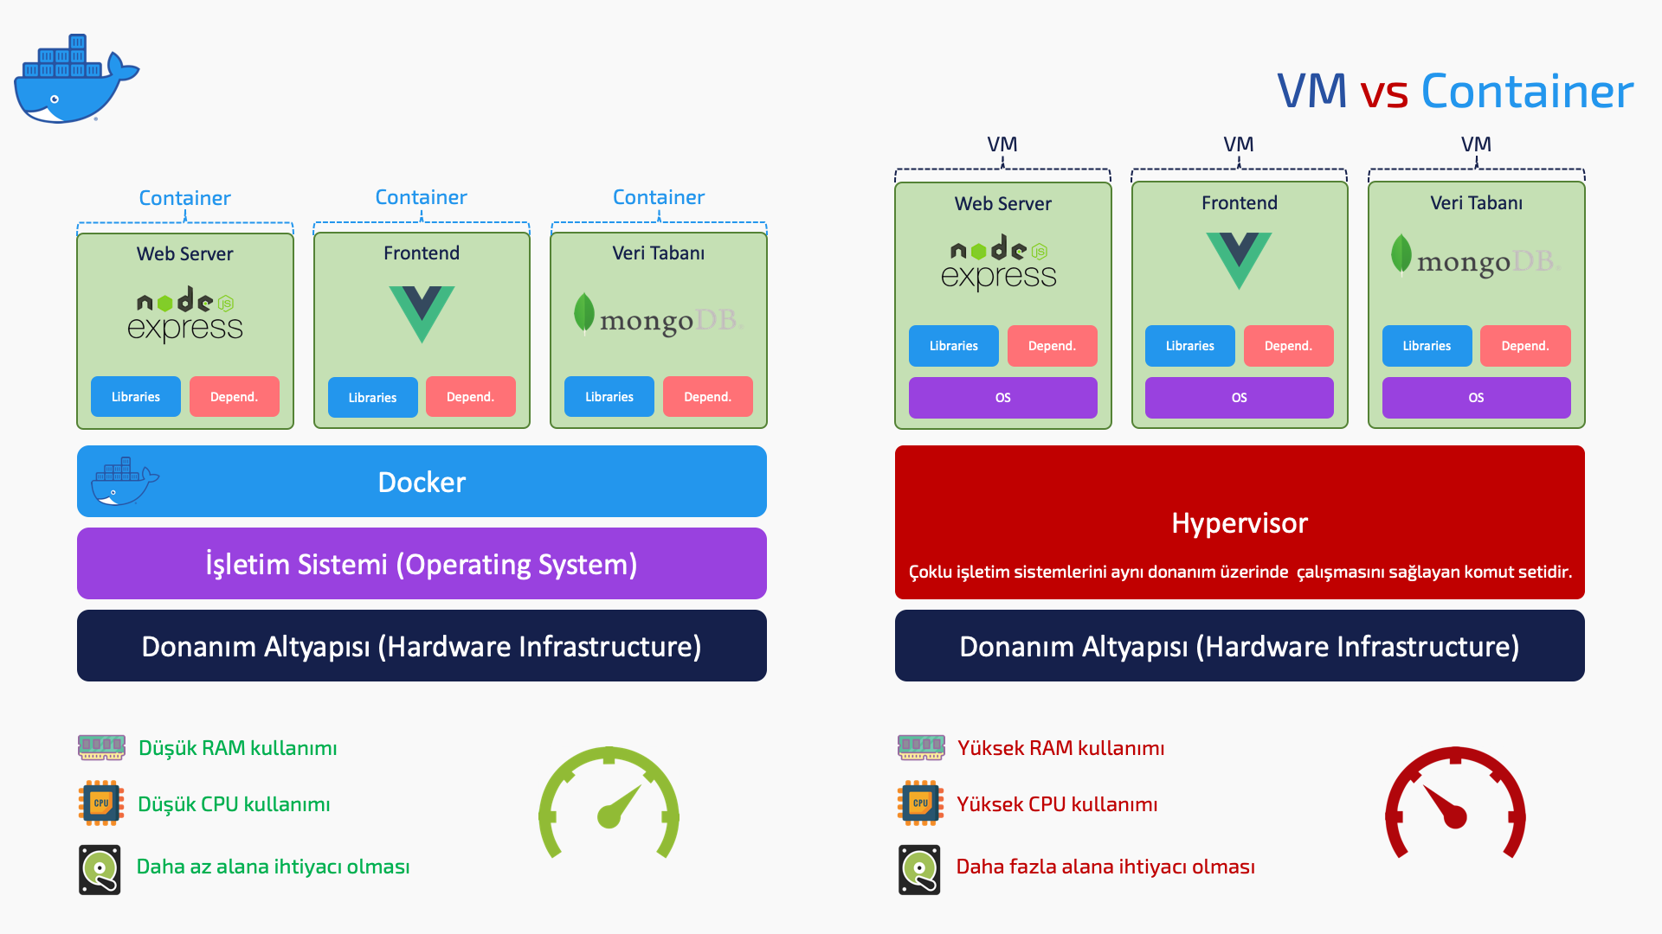
Containerization

Slide 8
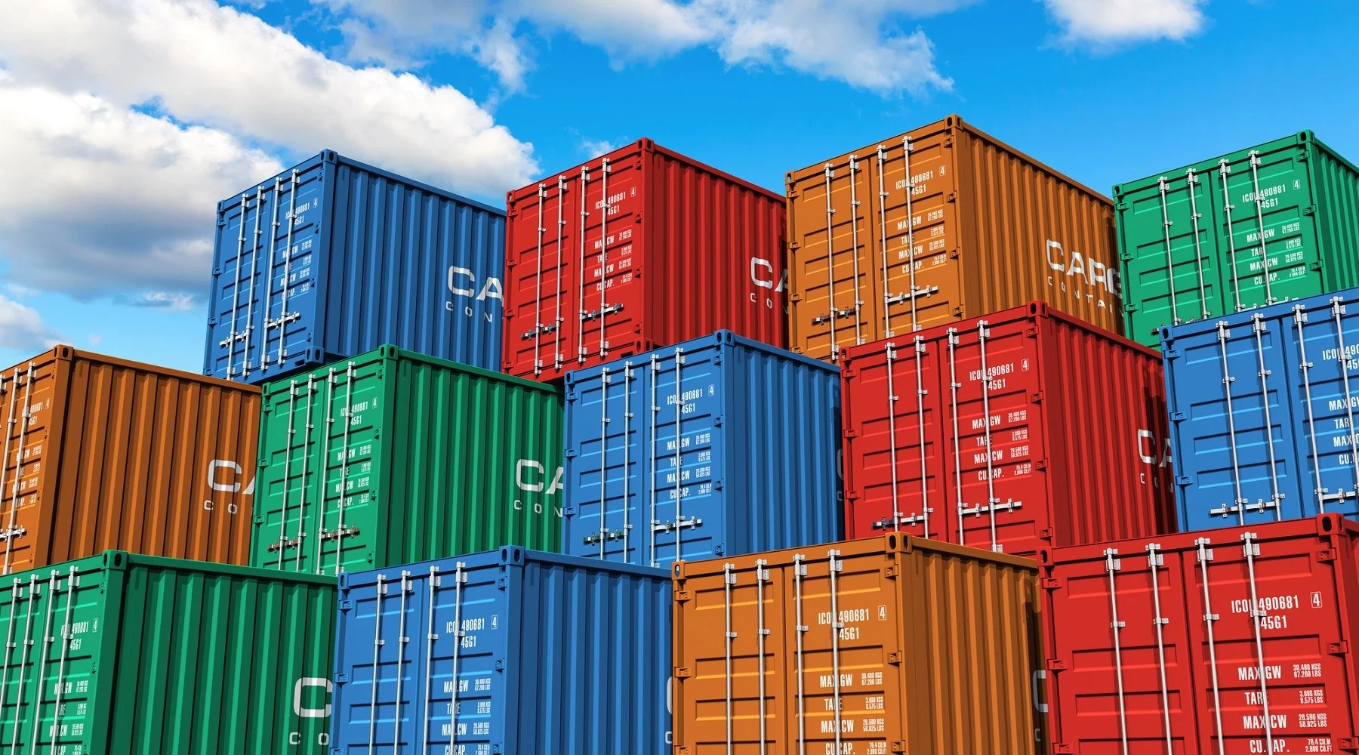
Containerization
Application Isolation
Rapid Deployment and Scalability
Portability
Lightweight and Speed
Continuous Integration and Delivery (CI/CD)
Orchestration (Kubernetes)

Slide 9

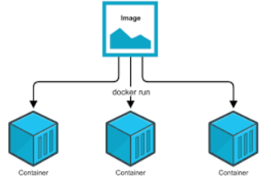
Containerization

Slide 10
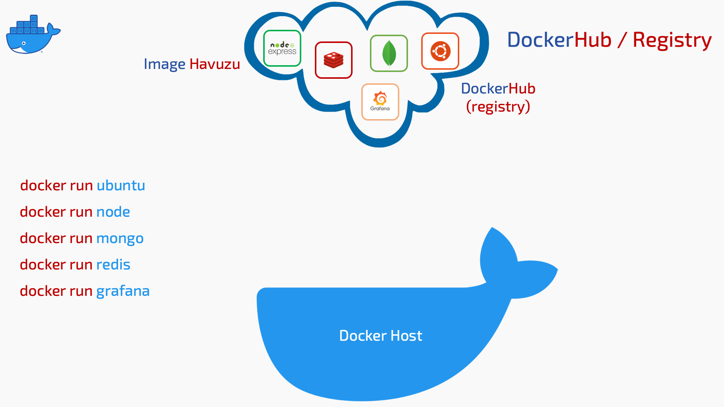
Containerization

Slide 11

Containerization

Slide 12
Docker Operations Hands-On
Building images of services written in different programming languages
Running docker containers
Reducing container image size
Image registry operations (login, pull, push)
Usage of docker volumes
Creating multiple container with docker-compose
Other useful docker commands

